Slide 1

Font Properties
By: Dalia Ihab

Slide 2


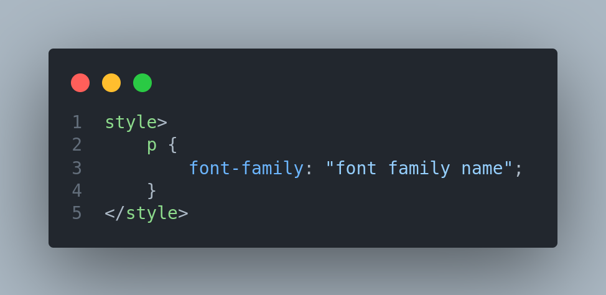
Font Family
It is used to set the font type of an HTML element. It holds several font names as a fallback system.

Slide 3
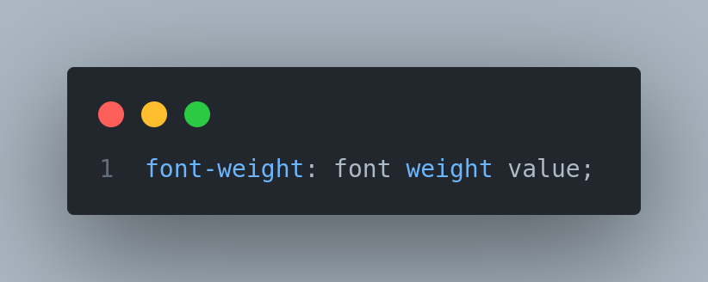
Font Weight
font-weight: It is used to set the boldness of the font. Its value can be “normal, bold, lighter, bolder”.

Slide 4
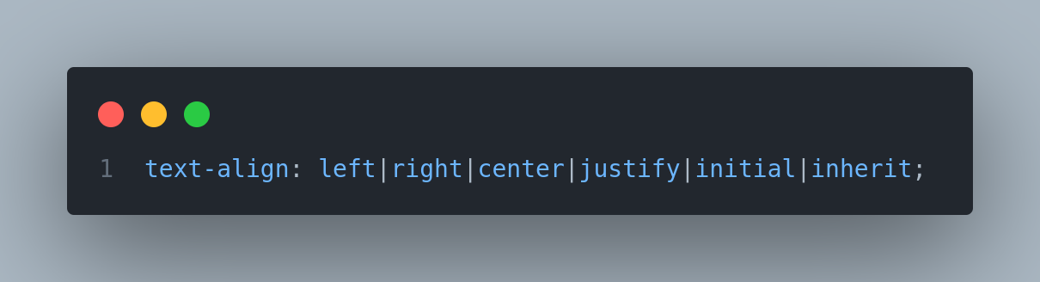
Text Align
The text-align property specifies the horizontal alignment of text in an element.

Slide 5
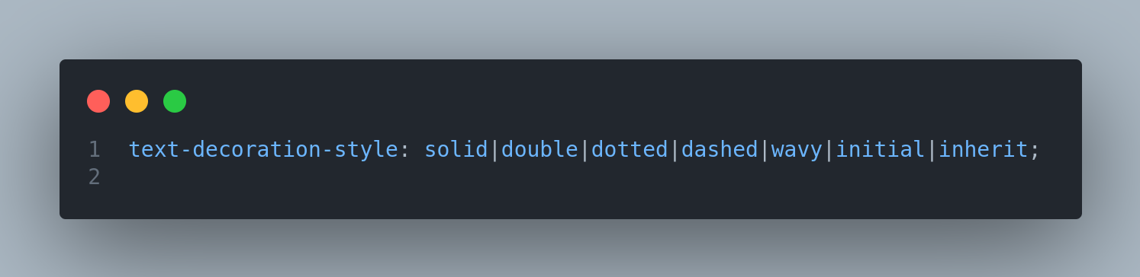
Text Decoration Style
The text-decoration property sets the style of the text decoration (like solid, wavy, dotted, dashed, double).

Slide 6


Next
Background and Cursor

